Slide 1
Neuroevolution and hyperparameter optimization for deep neural networks
Alberto TONDA, Team EKINOCS, UMR 518 MIA-PS

Slide 2
Things I want to add
NEAT (Risto Mikkaaulinen)
HyperNEAT
Latest developments by Nuno Lourenço et al.
Article on evolution of RNN for oil
HUMIES 2022

Slide 3
Outline
Defining a network topology
Classical approach
Reframing as an optimization problem
Evolutionary algorithms
Neuroevolution (NEAT, HyperNEAT, ...)
Hyperparameter optimization

Slide 4
Defining a network topology
Using a (deep) neural network for a task
Lots of (hyper-)parameters to decide:
Number of layers
Number of neurons/units per layer
Type of layers (Convolutional, MaxPooling, …)
Activation function (tanh, ReLu, Leaky ReLu, …)
Optimizer (ADAM, Adagrad, RMSprop, …)
Parameters (!) of the optimizer (learning rate, …)

Slide 5
Classical approach
Read literature and copy a topology used for similar task
If it does not work, change it a bit until it works
Experiments take time, so limited amount of attempts

Slide 6
Reframing as an optimization problem
Search space: all possible combinations of hyperparameters
Objective: maximize performance on the task
Obvious issues:
Search space is Vast (cannot be explored exhaustively)
Search space is mixed integer/categorical/floating point
Search space is (very likely) not convex

Slide 7
Reframing as an optimization problem
Neural Architecture Search (NAS)
Gradient descent
Reinforcement learning
Bayesian optimization
Focus mostly on hyperparameter values (NOT TOPOLOGY)
References
Elsken et al., Neural Architecture Search: A Survey, 2019

Slide 8
Evolutionary algorithms
Evolutionary algorithms (EAs) can work well in this situation!
Better than random
Usable when other techniques fail (exact, gradient-based, …)
Can deal with extremely complex (mixed) search spaces
What EAs do, in a nutshell:
Stochastic exploration of the search space
Biased towards areas with better values of cost function
To get values of cost function, they evaluate candidate solutions

Slide 9
Evolutionary algorithms
Return best solution(s)
Yes
Stop condition reached?
Generate and evaluate
initial population
Select parents and create offspring
Evaluate new solutions
Remove worst solutions
No

Slide 10
Evolutionary algorithms
Mutation: randomly modify existing solution
Return best solution(s)
Yes
Stop condition reached?
Generate and evaluate
initial population
Select parents and create offspring
Evaluate new solutions
Remove worst solutions
No
Crossover: swap pieces of two (or more) existing solutions

Slide 11
Evolutionary algorithms: principle of locality
In general, small modifications to genotype should correspond to small modifications to phenotype and fitness
Quite important for good performance of EAs
References
F. Rothlauf, Representations for Genetic and Evolutionary Algorithms, 2006
F. Rothlauf and M. Oetzel, On the Locality of Grammatical Evolution, 2006

Slide 12
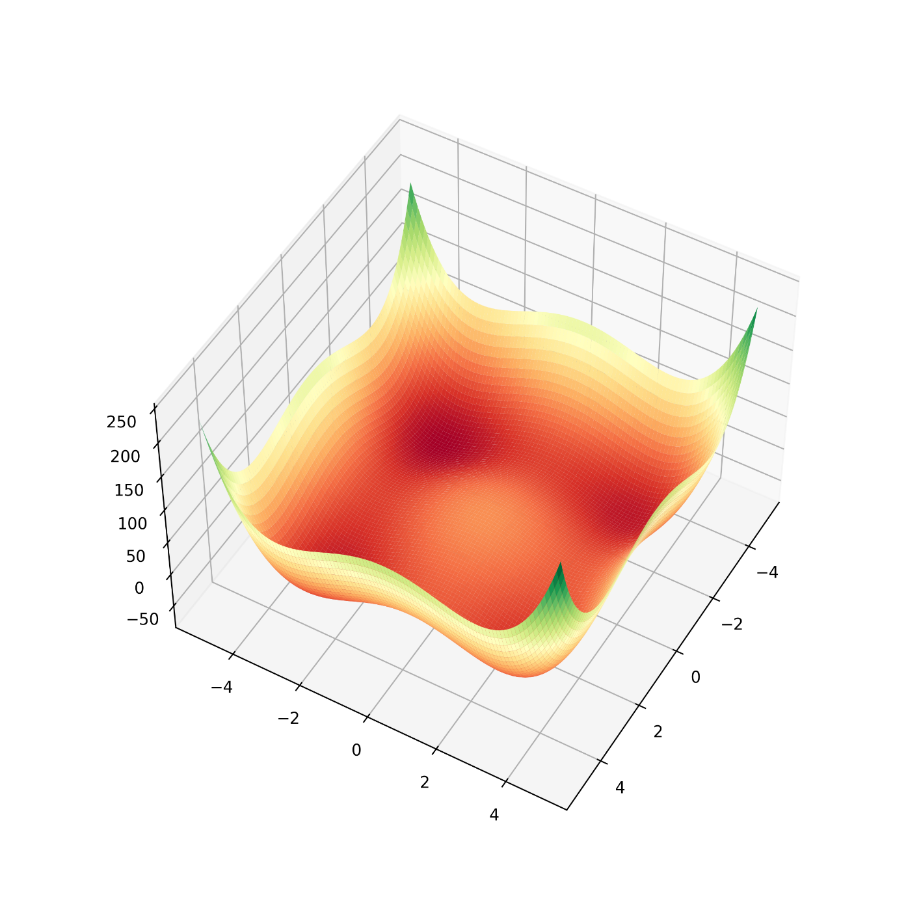
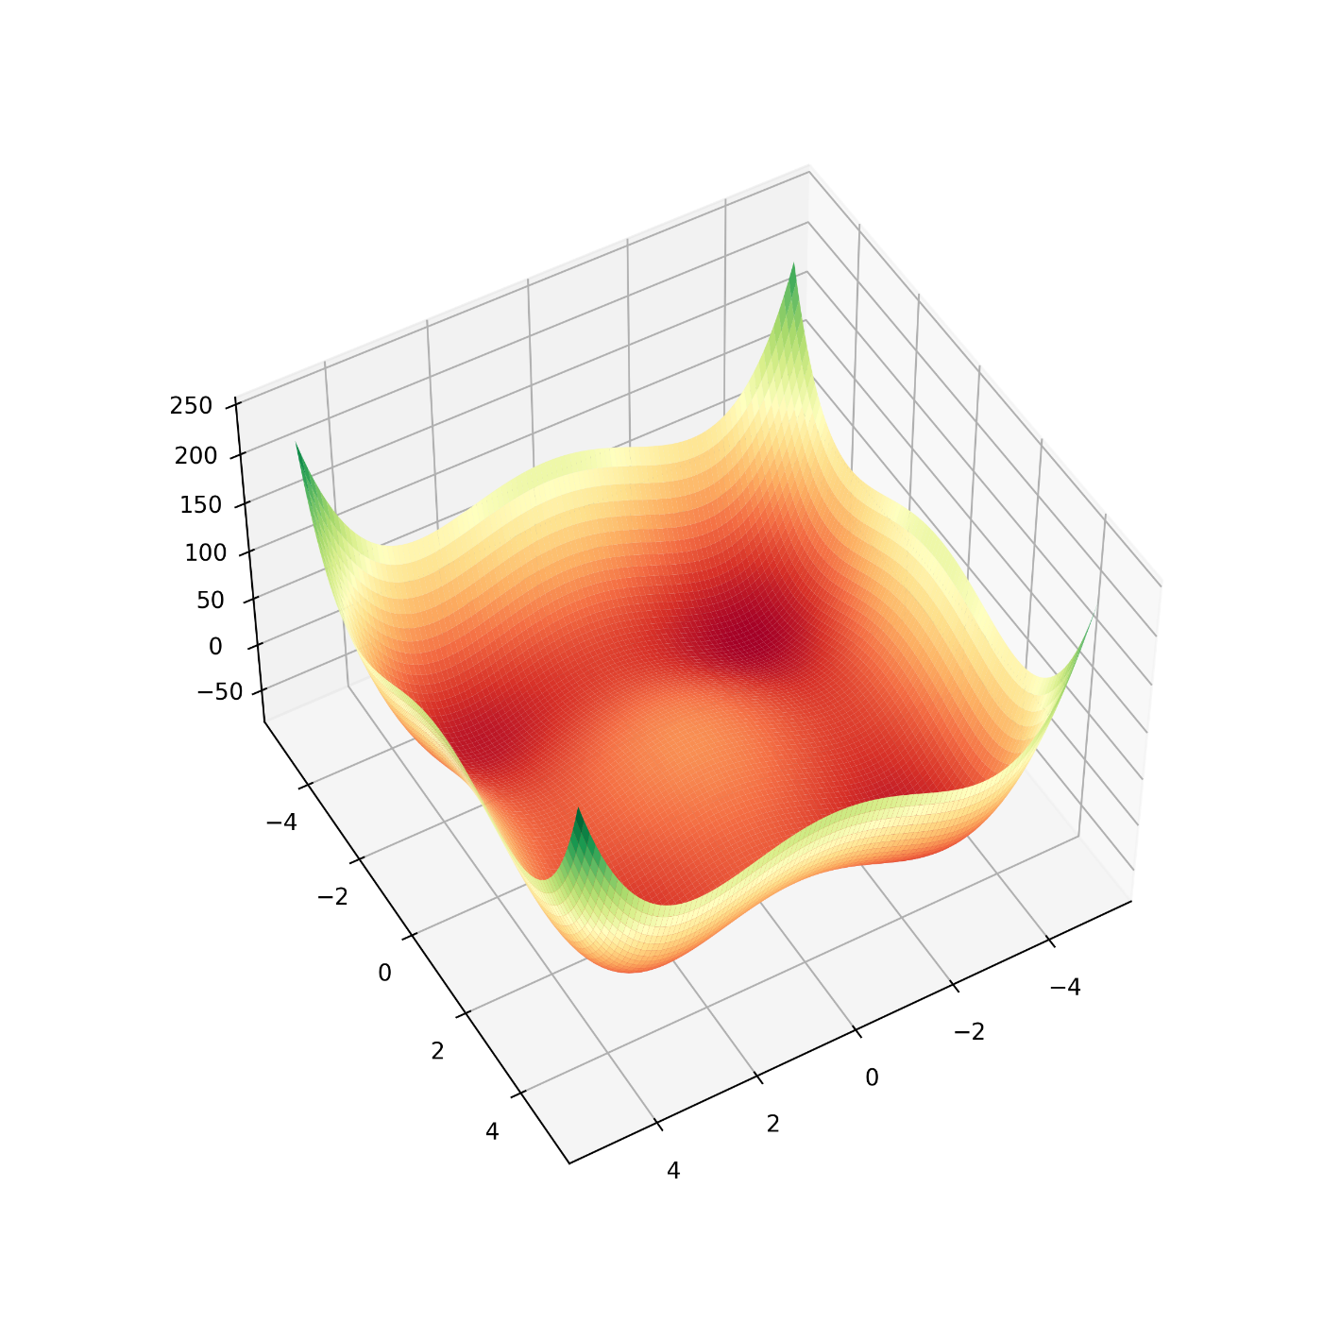
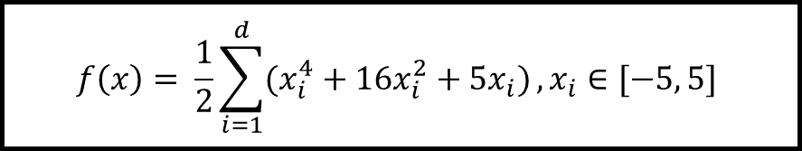
Evolutionary algorithms
$$f\left(x\right)= \frac{1}{2}\sum_{i=1}^{d}{(x_{i}^{4}+16x_{i}^{2}+5x_{i})}, x_{i}∈[−5, 5]$$

Slide 13
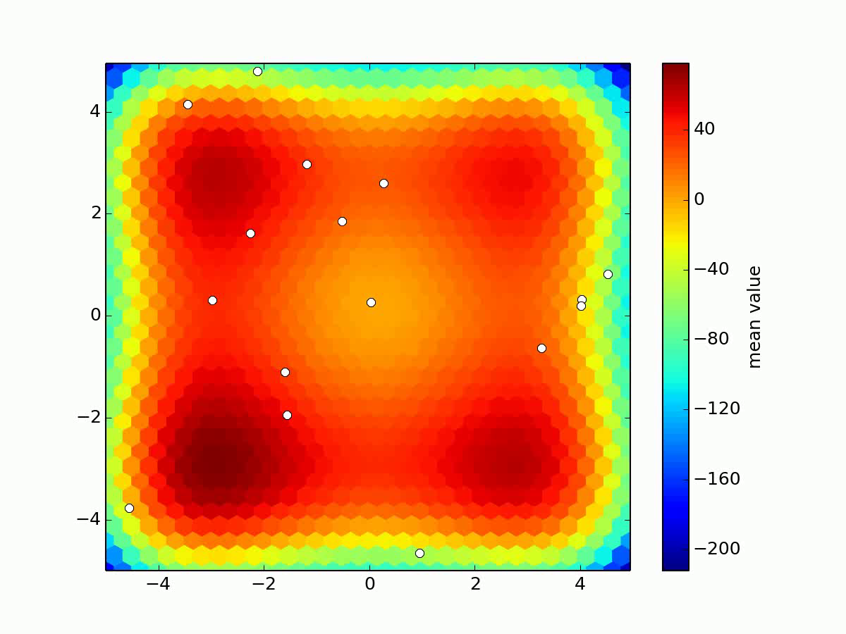
Introduction to Evolutionary Computation
Notes:
They can be used for other purposes, but in this presentation I will focus on optimization. Who here has used evolutionary algorithms, also known as “Genetic Algorithms”?
They are inspired by the neo-Darwinian understanding of natural selection. But keep in mind that this is just a metaphor, they are as close to natural selection as artificial neural networks are close to the brain, which means, very little.
There is some domain-specific terminology that I will try not to use too much. But basically, a candidate solution is sometimes called “individual”; the set of candidate solutions at the current iteration is called “population”; and the new solutions produced at each iteration are called “offspring”

Slide 14
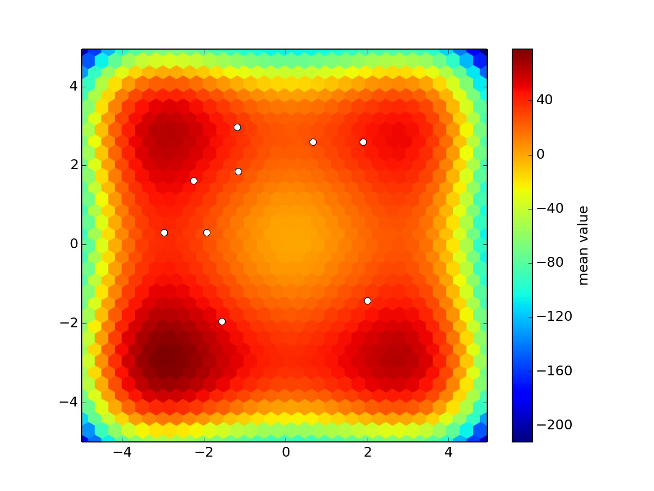

Slide 15
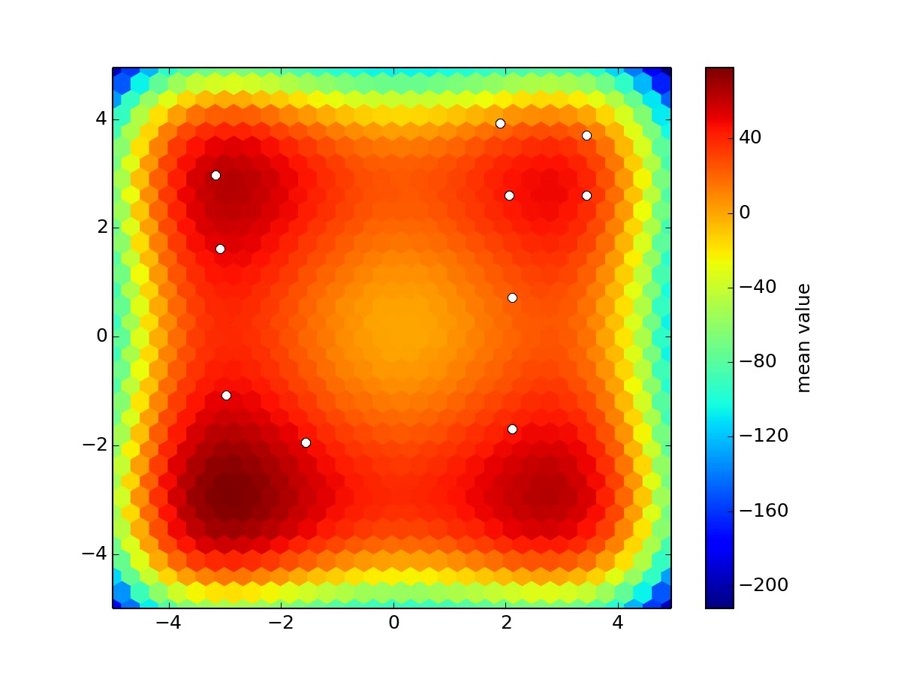

Slide 16


Slide 17


Slide 18


Slide 19


Slide 20
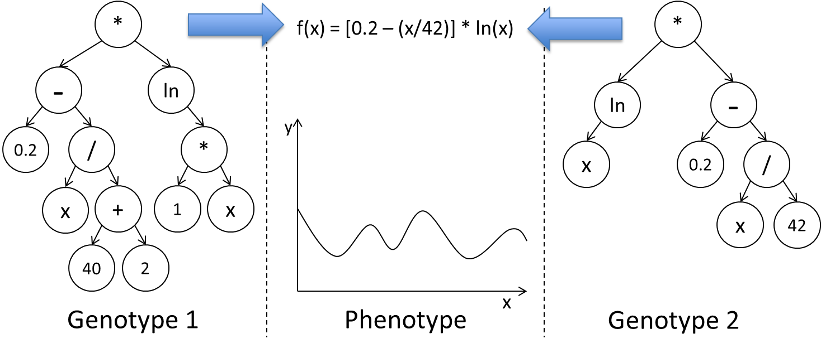
Evolutionary algorithms: principle of locality
Complex solutions, use indirect representation
There is a mapping between internal representation (genotype)
And external representation (phenotype)
Example: equations (phenotype) as trees (genotype)

Slide 21
Evolutionary algorithms: mutation
α
α
β
γ
β
γ
δ
ε
ζ
δ
ε
λ
η
θ
η
θ

Slide 22
Evolutionary algorithms: crossover

Slide 23
Evolutionary algorithms: crossover

Slide 24
Evolutionary algorithms: crossover

Slide 25
Neuroevolution
Basic idea: optimize network topology (and possibly weights)
Considerable amount of works since mid-1990s
Risto Miikkaulinen (Finnish-American, U. of Texas)
Group at University of Coimbra (Portugal)
Summary of a few papers
Evolving Neural Networks through Augmenting Topologies (Stanley and Miikkulainen, 2002)

Slide 26
Neuroevolution: main issues
Return best solution(s)
Yes
Stop condition reached?
Generate and evaluate
initial population
Select parents and create offspring
Evaluate new solutions
Remove worst solutions
No

Slide 27
Neuroevolution: main issues
Evaluations are (VERY) COMPUTATIONALLY EXPENSIVE
Return best solution(s)
Yes
Stop condition reached?
Generate and evaluate
initial population
Select parents and create offspring
Evaluate new solutions
Remove worst solutions
No

Slide 28
Neuroevolution: main issues
Assess performance in a CROSS-VALIDATION
Evaluations are (VERY) COMPUTATIONALLY EXPENSIVE
Return best solution(s)
Yes
Stop condition reached?
Generate and evaluate
initial population
Select parents and create offspring
Evaluate new solutions
Remove worst solutions
No

Slide 29
Neuroevolution: main issues
Depending on the representation, PRINCIPLE OF LOCALITY might fail
Return best solution(s)
Yes
Stop condition reached?
Generate and evaluate
initial population
Select parents and create offspring
Evaluate new solutions
Remove worst solutions
No

Slide 30
Neuro-Evolution of Augmenting Topologies

Slide 31
Neuro-Evolution of Augmenting Topologies
But does it REALLY work?
In other words, is it competitive with human design?
There is some evidence that yes, it does work
HUMIES 2022 (Human-Competitive Awards)
https://human-competitive.org/
Miikkulainen et al., Evaluating Medical Aesthetics Treatments through Evolved Age-Estimation Models, GECCO 2021
Better results than human-designed neural network

